Slide 1
Emission testing

Slide 2
EMISSION TEST PROCEDURES
The vehicle emission limits are specified based on a standard test procedure, which includes;
A specified vehicle driving or engine operation schedule of varying speeds and loads which represents real life driving/usage pattern of the vehicles and engines. The test schedule of vehicle or engine operation is known as ‘driving cycle’.
Use of emission sampling systems and analyzers that operate on the working principles specified in the emission regulations.
The new production vehicles and engines are tested for compliance with the emission standards in a government approved laboratory

Slide 3
Units of Emission Limits
Two types of emission limits are specified in the standards
For the light and medium duty vehicles, passenger cars and, two and three wheelers are in terms of mass of pollutant emitted per unit distance travelled i.e., g/km ( g/mile in the USA , 1 g/km = 1.61 g/mile).
For heavy duty vehicles and engines test is carried on the engine itself and the limits are specified in terms of mass of pollutant per unit of work done, i.e., g/kW-h or g/bhp-h (1 g/kW-h = 1.34 g/bhp-h) .

Slide 4
Driving Cycles for Light Duty Vehicles
The cycle is composed of a cold start period, idling, moderate acceleration and deceleration, and cruise modes.
The test cycle is given in terms of vehicle speed versus time.
The test cycle is given in terms of vehicle speed versus time.
The road horsepower requirement versus speed data as provided by the vehicle manufacturer is stored into chassis dynamometer controller to simulate the real life road operation of the vehicle.

Slide 5
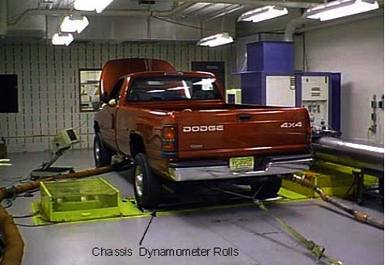

Slide 6
European Test Driving Cycle
Consists of two parts
urban driving cycle (ECE 15) and
extra-urban driving cycle (EUDC)

Slide 7
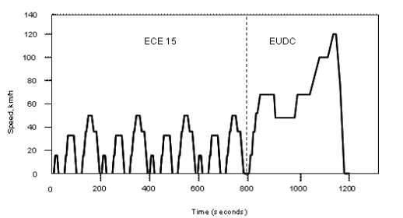

Slide 8
The engine starts, the car pauses for 11 s - if equipped with a manual gearbox, 6 s in neutral (with clutch engaged) and 5 s in the 1st gear (with clutch disengaged) - then slowly accelerates to 15 km/h in 4 s, cruises at constant speed for 8 s, brakes to a full stop in 5 s (manual: last 3 s with clutch disengaged), then stops for 21 s (manual: 16 s in neutral, then 5 s in the 1st gear).
At 49 s, the car slowly accelerates to 32 km/h in 12 s (manual: 5 s in 1st gear, 2 s gear change, then 5 s in the 2nd gear), cruises for 24 s, slowly brakes to a full stop in 11 s (manual: last 3 s with clutch disengaged), then pauses for another 21 s (manual: 16 s in neutral, 5 s in the 1st gear).
At 117 s, the car slowly accelerates to 50 km/h in 26 s (manual: 5 s, 9 s and 8 s in the 1st, 2nd and 3rd gears, with additional 2 × 2 s for gear changes), cruises for 12 s, decelerates to 35 km/h in 8 s, cruises for another 13 s, brakes to a full stop in 12 s (manual: 2 s change to the 2nd gear, 7 s in the 2nd gear, last 3 s with clutch disengaged), then pauses for 7 s (manual: in neutral with clutch engaged).
The cycle ends on 195 s after a theoretical distance of 994.03 meters, then it repeats four consecutive times. Total duration is 780 s (13 minutes) over a theoretical distance of 4052 meters, with an average speed of 19 km/h.

Slide 9
After a 20 s stop - if equipped with manual gearbox, in the 1st gear with clutch disengaged - the car slowly accelerates to 70 km/h in 41 s (manual: 5 s, 9 s, 8 s and 13 s in the 1st, 2nd, 3rd and 4th gears, with additional 3 × 2 s for gear changes), cruises for 50 s (manual: in the 5th gear [sic]), decelerates to 50 km/h in 8 s (manual: 4 s in the 5th and 4 s in the 4th gear [sic]) and cruises for 69 s, then slowly accelerates to 70 km/h in 13 s .
At 201 s, the car cruises at 70 km/h for 50 s (manual: in the 5th gear), then slowly accelerates to 100 km/h in 35 s and cruises for 30 s (manual: in the 5th or 6th gear).
Finally, at 316 s the car slowly accelerates to 120 km/h in 20 s, cruises for 10 s, then slowly brakes to a full stop in 34 s (manual: in the 5th or 6th gear, last 10 s with clutch disengaged), and idles for another 20 s (manual: in neutral).
Total duration is 400 s (6 minutes 40 s seconds) and theoretical distance is 6955 meters, with an average speed of 62.5 km/h.

Slide 10
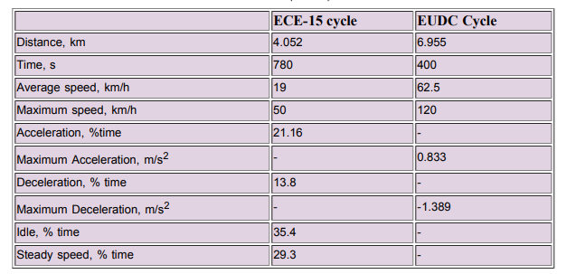

Slide 11
INDIAN EMISSION STANDARDS

Slide 12
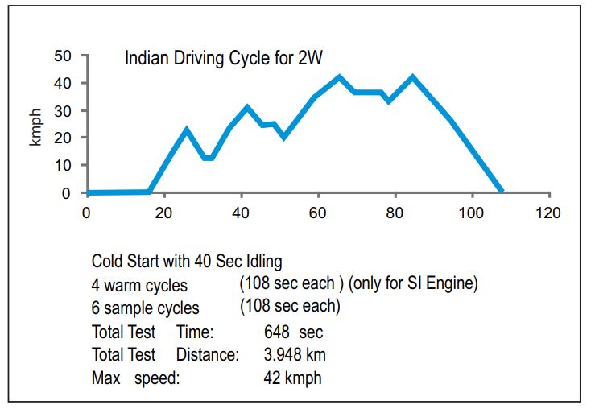
INDIAN DRIVING CYCLE FOR TWO WHEELERS

Slide 13
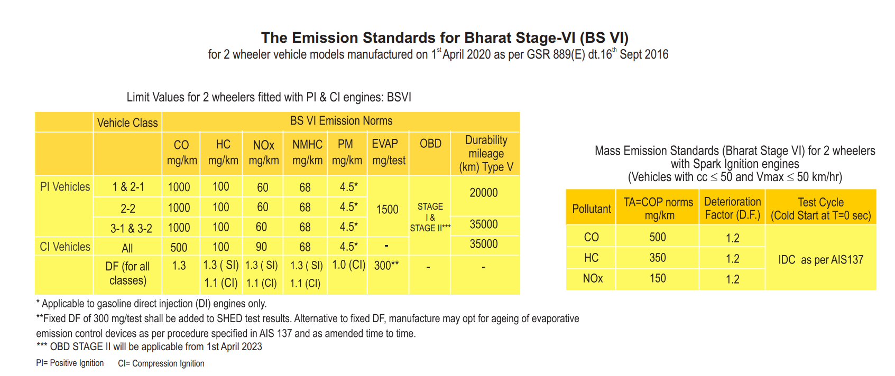
The Emission Standards for Bharat Stage-VI (BS VI) for Two wheeler vehicle models

Slide 14
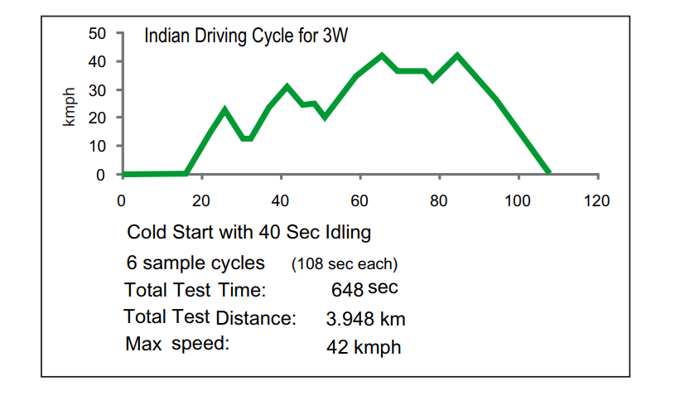
INDIAN DRIVING CYCLE FOR THREE WHEELERS

Slide 15
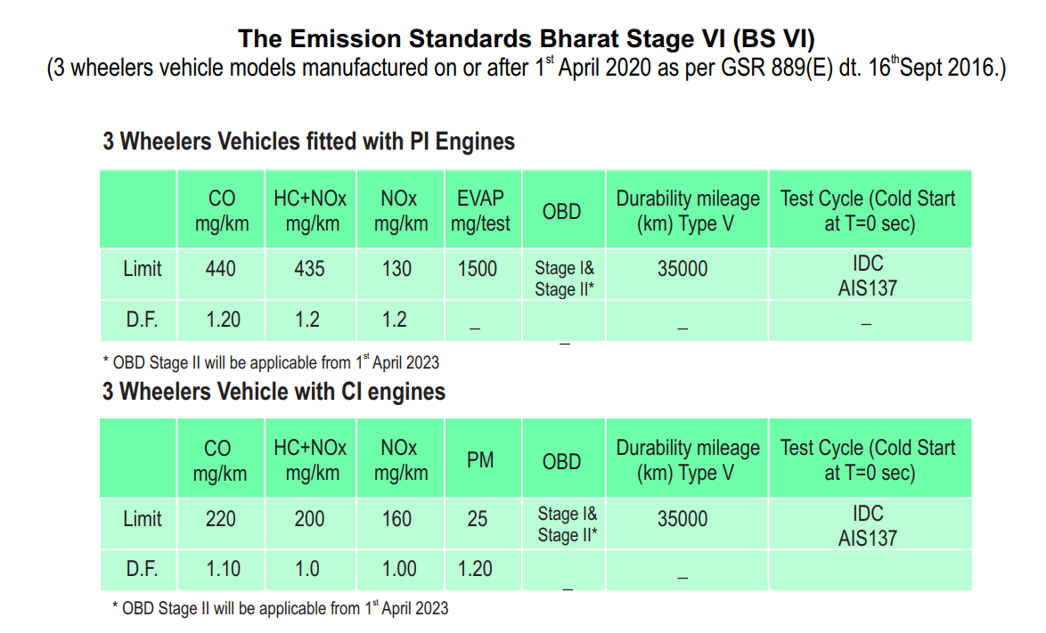
The Emission Standards for Bharat Stage-VI (BS VI) for Three wheeler vehicle models

Slide 16
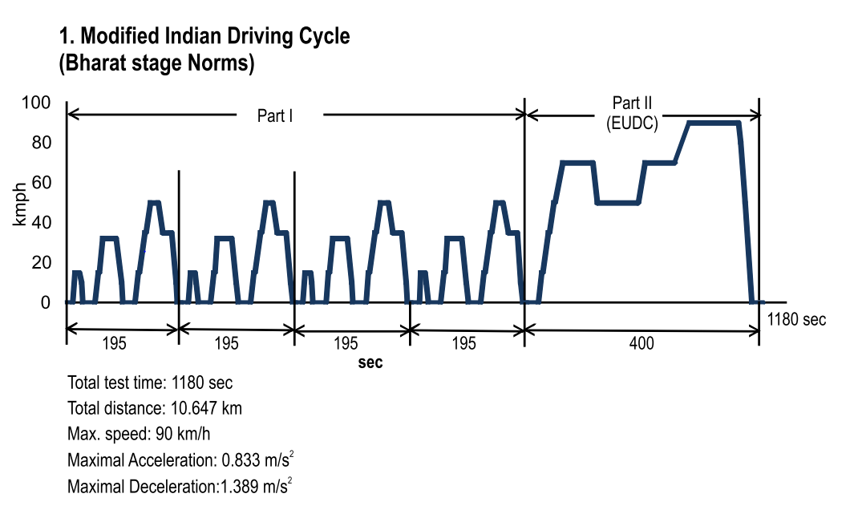
Driving cycle for Light motor Vehicles

Slide 17
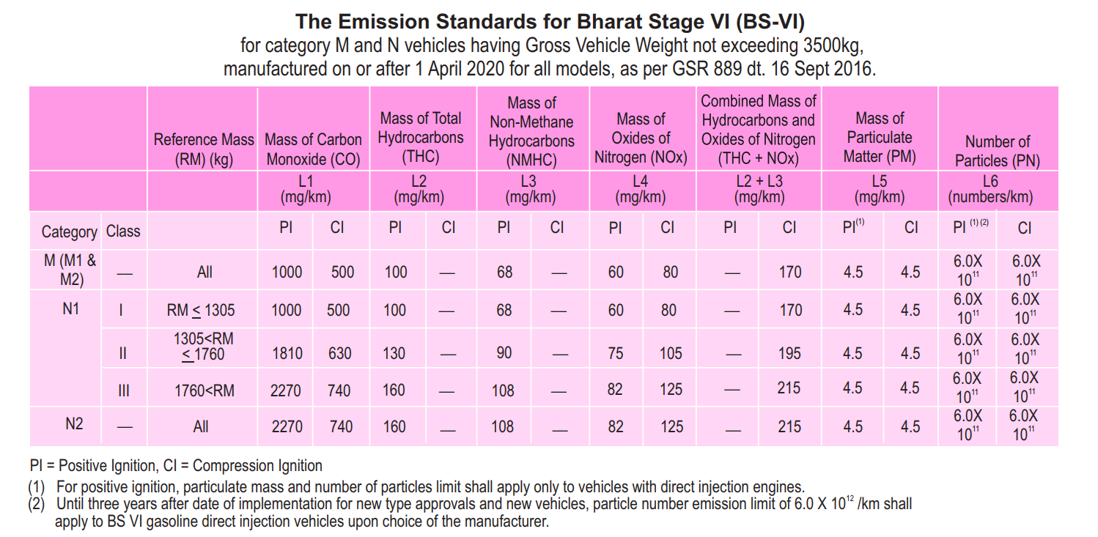

Slide 18
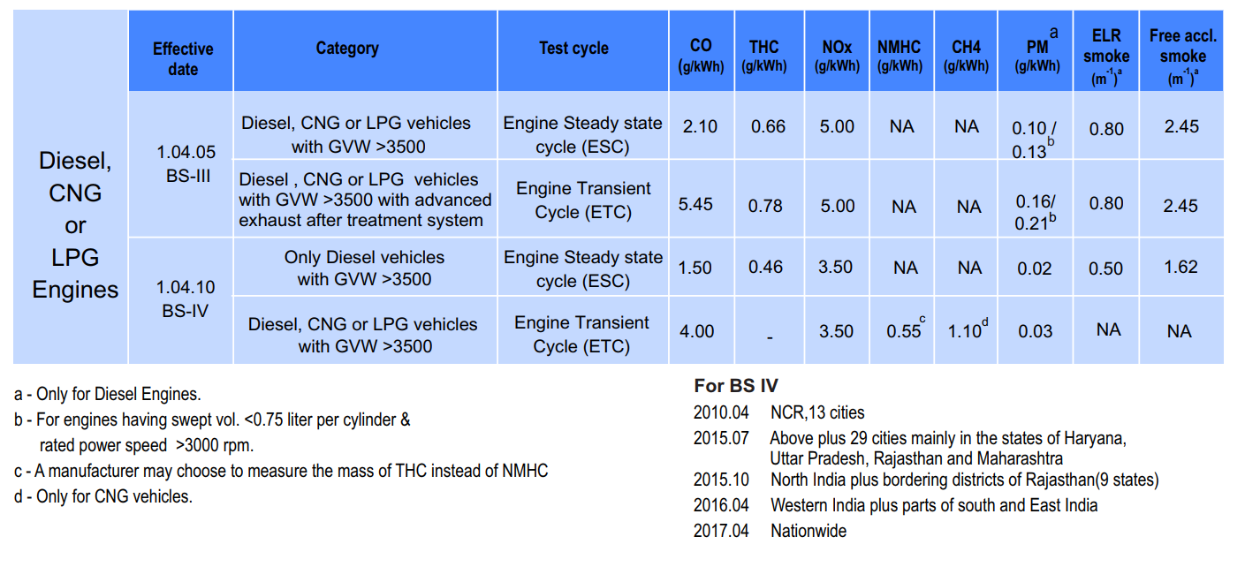
Emission Standards for Heavy Duty Commercial Engines Heavy Duty Vehicles (GVW > 3500 kg)

Slide 19
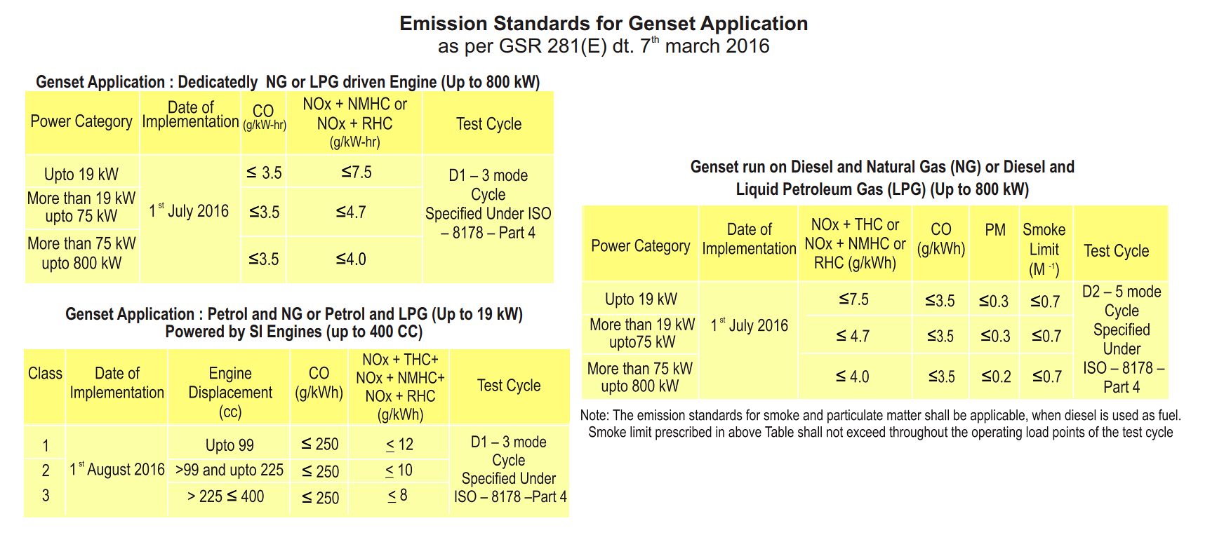

Slide 20
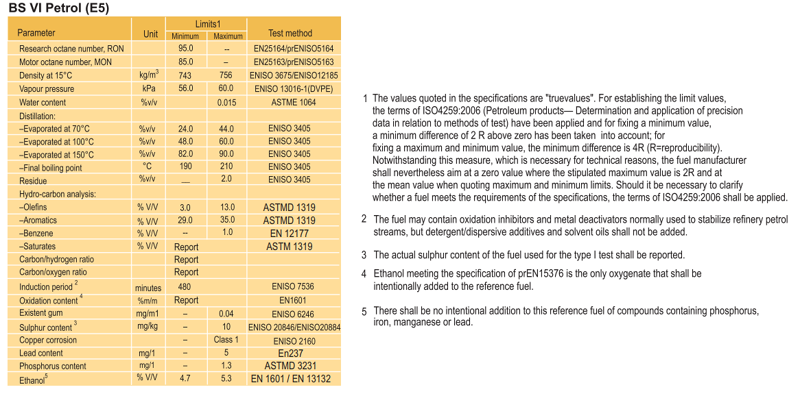
BS VI Reference Fuel Specification

Slide 21
